Slide 1
CoffeeScript, Linguistics and Cockney Rhyming Slang
Brandon Satrom
@BrandonSatrom
UserInExperience.com
Notes:
Thanks Chris! Good morning, afternoon or evening everyone. I’m excited to be here today to talk with you all about CoffeeScript. My name is Brandon Satrom, and you can find me on Twitter as BrandonSatrom or on my blog at UserInExperience.com. [NEXT]

Slide 2


Me, in Three Slides
Husband and Father
Program Manager for Kendo UI
Austin, TX
www.userinexperience.com
@BrandonSatrom
github.com/bsatrom
Notes:
A little bit about me. My wife and I live in Austin, TX, where we do our best to keep up with our two awesome little boys. I’m also the Program Manager for Kendo UI, an HTML5 framework for building rich front-end desktop and mobile applications.

Slide 3

#html5tx
02.02.13
HTML5tx.com
@HTML5tx
Notes:
I’m also the founder of the HTML5.tx conference, based in Austin, Texas. The next incarnation will be on February 2nd, 2013, and you can check us out at HTML5tx.com.

Slide 4

My Book
http://bit.ly/Win8Book
Notes:
Finally, I’m one half of the writing team for an upcoming book on building apps for Windows 8 using HTML, CSS and JavaScript. So, if you’re dipping your toe into any Windows 8 development, please check it out.

Slide 5

CoffeeScript? RLY?
Notes:
With all that formality out of the way, let’s talk about CoffeeScript. First, the elephant in the room, which is why in the world you’re listening to a CoffeeScript talk as a part of the CSS Summit. As you are no doubt are aware, today is all about pre-processors and even though most of the topics relate to CSS-based preprocessors, there’s no question that we’re seeing an explosion of interest in preprocessors for JavaScript as well. With CoffeeScript being one of the most popular of these, Christopher wanted a talk that introduces CoffeeScript, and helps paint a picture of the broader landscape of pre-processors in the front-end world.

Slide 6
pre- + processor
“…a program that processes its input data to produce output that is used as input to another program.” (Source: Wikipedia)
When applied to the web, the term usually means a language that can be combined with a transpiler to output a canonical “web language,” like JavaScript or CSS.
Notes:
Of course, regardless of whether they target CSS, JavaScript or HTML, Pre-processors are the source of a lot of controversy because, to many, they “muddy up the web.” As much as we’ve all had our issues over the years with the capabilities of CSS, JavaScript and HTML, as well as the somewhat glacial pace of change, the homogeneity that we’ve all grown up with on the web has had its benefits. Namely, it’s predictable and consistent, and front-end work has traditionally meant the same thing regardless of client or company.
Preprocessors throw a wrench into the works of the web in this regard, because they effectively introduce wholesale alternatives to the languages we’re used to. Now, with each new client, the question becomes: will I be doing CSS, or does the existing team Prefer LESS or SASS. And the same goes for JavaScript once languages like CoffeeScript and DART are introduced.

Slide 7

Web Development is Changing
CC image copyright Miguel Angel Sune, used with Permission - http://www.flickr.com/photos/miguel9120_fotos/6762014771/
Notes:
However, even without considering preprocessors, there’s no question that the web is moving much faster now than it ever has before. And it’s not just markup, and API specs. It’s also the languages we use to craft the web. CSS Modules like Variables, and cutting-features of ECMAScript 6 are examples of how these languages themselves are changing. And the fact is, that many of these cutting-edge features have been influenced by features in popular preprocessors.

Slide 8
PreProcessors, The Web and You
(aka, Brandon’s Golden Rules for Pre-Processor Adoption)
Notes:
So there’s no doubt that preprocessors are becoming a fact of life, and they are becoming the tools of choice for a growing number of designers and developers. We don't have to embrace them, but we do need to understand them. And that includes understanding why they are popular and people are adopting them. So, when it comes to Preprocessors in general, and CoffeeScript in particular, I thought I’d share the two golden rules I live by when forming an opinions about these libraries.

Slide 9
#1 - Use a preprocessor before forming an opinion about it
"The challenge with new programming tools is that, unlike conventional tools, we don't know what they're good for without a lot of experimentation." – iamnoah (https://gist.github.com/3200682)
Notes:
First, is that you should use a pre-processor before forming an opinion about it.

Slide 10
#2 – If a Preprocessor Helps you Do your Job Better, Use it.
… and if not, don’t.
Notes:
Second, if a preprocessor helps you do your job better, use it. If not, don’t. It’s a simple as that. Don’t let someone else decide for you if LESS, or SASS or CoffeeScript is useful to you, try it for yourself. Also, don’t ever worry about this becoming a permanent decision. Don’t fear lock-in. If you ever decide to stop using a preprocessor, take the output and run.

Slide 11


VS.
Notes:
Now that we’ve talked a bit about Preprocessors in general, let’s talk more about CoffeeScript. I expect that there are three types of people here today when it comes to CoffeeScript. You’re either:
A die hard CoffeeScript Fan
Skeptical of CoffeeScript
Don’t have enough information to decide yet
I think a lot of people would place them in that last category. However, I think it’s fair to say that most of us tend to view CS and JS as an either-or decision. We must debate about them, and decide which is better, as we do with all things in life.

Slide 12
A JavaScript Dialectic
Notes:
There are lots of ways to conduct arguments or discussions.
There is the “Beard Slap” extreme, where arguments are settled by force
Then there is settling arguments via rhetoric
Debates are a little bit better, but each side still comes to the table with the goal of winning.
Today, I would like to propose that we take a dialectical approach to CoffeeScript.
A Dialectic is a method for resolving disagreement, around in both Western and Eastern philosophy for thousands of years.
“Dialogue between two or more people holding different points of view about a subject, who wish to establish truth of the matter by dialogue, with reasoned arguments.”
- This is different than debate, where each party is committed to their points of view and mean to win the debate.
- Also different than rhetoric, which appeals to emotion rather than logic and reason.

Slide 13


Don’t Be A JavaScriptster
I loved JavaScript before it was cool
Of course, I also hated it back when everyone else did too…
Notes:
If you are skeptical, though, I only ask that you not be a JavaScripster. Be willing to consider the place that CoffeeScript might have in your own development, and do try it for yourself.
The point of a dialectic, at least as I understand it, is to bring people with opinions together. As long as the people are more interested in knowledge and progress than “winning the argument,” there is potential for everyone to learn and to grow in their thinking. I may represent one viewpoint, but I am open to having my own mind changed by you all. I hope, in the course of this conversation, that we can all leave with different perspectives on CoffeeScript, but also JavaScript in general.

Slide 14
What?
What is CoffeeScript?
Notes:
Let’s talk about What CoffeeScript is. Now I’m assuming that, since this is a JS conference, most of you already know, and you probably know a bit about the language itself. So I’m not going to linger here, because I think the dialectic part of this presentation is of larger importance.

Slide 15
“It’s Just JavaScript”
Or “Unfancy JavaScript”
Notes:
The first rule of CoffeeScript, according to its website, is “It’s just JavaScript”

Slide 16
“A little language”
Notes:
It’s also a little language. CoffeeScript is different than these “big, existing language compiling to JS” frameworks in that it’s not designed to let you write JavaScript in some other existing language or framework. Many of those let you use framework libraries, and thus have to replicate them to JS, which is why “Hello World” in DART is 17,209 lines of code.
CoffeeScript is a NEW language, inspired by others. And believe it or not, it wasn’t created as a way to help you avoid JavaScript all together.

Slide 17
More A Dialect, Less A Language
Color === Colour
function(foo) {} === (foo) ->
Notes:
Let’s put it in less controversial terms. It’s helpful to think of CoffeeScript more like a dialect of JavaScript, and less like an entirely new, foreign language.

Slide 18
Subtle Linguistics
Dave has two children. His youngest is in Reception, and his favourite colour is green. His oldest is Year 4, and loves to ride the lift outside his flat.
Dave has two children. His youngest is in Pre-K, and his favorite color is green. His oldest is in 3rd Grade, and he loves to ride the elevator outside his apartment.
Notes:
Think of CoffeeScript and JavaScript like the Queens English and American English. They are syntactically equivalent, with only slight variations on spelling and popular word choice. As a native english speaker, I can read and understand both, and can either deduce or look up what I don’t. My mind transcompiles the Queen’s english in print or spoken form to the native semantics I understand.
Neither linguistic choice is more right or wrong than the other, because the choice is mostly dictated by cultural and local factors.
[Awesome to have an animation effect here that highlights words in each paragraph, then fades out the american text, replaces it with british and pulls back in american text]

Slide 19
Not so subtle linguistics…
Sentence | Extended Phrase | Rhymes With
I’ve got a sore billy. | Billy Goat | Throat
That’s a nasty old boris you’ve got there son. | Boris Karloff | Cough
Ere, you’ve got your brass wrong! | Brass Tacks | Facts
‘ow about a Brittney? | Brittney Spears | Beers
We’re all in Barney! | Barney Rubble | Trouble
Think he’s been smoking a bit of Bob | Bob Hope | (you get the idea)
Notes:
Of course, some might argue that the difference between CoffeeScript and JavaScript is more like American English and Cockney Rhyming slang, than American and The Queens English. In this case, the differences between the language require an intermediate processing step, whereby a key phrase must be expanded upon, then mapped to the best rhyming equivalent that makes sense in the context of the sentence.
I would argue, this is more like DART, but it does make an important point, both about learning a language and about CoffeeScript vs. JavaScript.
If you’re coming to English as a non-native speaker, the subtle to major differences between American English, the Queens English and Cockney Rhyming Slang can prove to be major pitfalls to being productive with capital E English. They will slow you down. This brings me to my first categorical imperative about CoffeeScript.

Slide 20
CoffeeScript is not a replacement for Learning JavaScript
Notes:
In traditional logic, an axiom or postulate is a proposition that is not proven or demonstrated but considered either to be self-evident or to define and delimit the realm of analysis. In other words, an axiom is a logical statement that is assumed to be true. Therefore, its truth is taken for granted, and serves as a starting point for deducing and inferring other (theory dependent) truths.

Slide 21
Compiles 1:1 to JavaScript
1:1 being Concept to Concept
Notes:
Let’s get back to CoffeeScript itself. The biggest reason why I’m claiming that CoffeeScript is a dialect of JavaScript is because is compiles 1:1 to JavaScript. This doesn’t mean 1 line to 1 line, but 1 concept to 1 concept.

Slide 22
Conceptual Equivalence
CoffeeScript
JavaScript
numbers = [1..10]
printNum = (number) ->
console.log "This is number #{number}"
printNum for num in numbers
var num, numbers, printNum, _i, _len;
numbers = [1, 2, 3, 4, 5, 6, 7, 8, 9, 10];
printNum = function(number) {
return console.log("This is number " + number);
};
for (_i = 0, _len = numbers.length; _i < _len; _i++) {
num = numbers[_i];
printNum;
}
Notes:
Let’s take a look at what that means
This first line shows both variable declaration and assignment, as well as an array declaration. The right-hand side shows the exact JavaScript that CoffeeScript generates.

Slide 23
Conceptual Equivalence
CoffeeScript
JavaScript
numbers = [1..10]
printNum = (number) ->
console.log "This is number #{number}"
printNum num for num in numbers
var num, numbers, printNum, _i, _len;
numbers = [1, 2, 3, 4, 5, 6, 7, 8, 9, 10];
printNum = function(number) {
return console.log("This is number " + number);
};
for (_i = 0, _len = numbers.length; _i < _len; _i++) {
num = numbers[_i];
printNum(num);
}
Notes:
The second example shows a function definition. This tends to be the biggest shift for people because of the syntax, and because a function block is whitespace significant. It is a matter of taste, but again, conceptually equivalent to the final JS.

Slide 24
Conceptual Equivalence
CoffeeScript
JavaScript
numbers = [1..10]
printNum = (number) ->
console.log "This is number #{number}"
printNum num for num in numbers
var num, numbers, printNum, _i, _len;
numbers = [1, 2, 3, 4, 5, 6, 7, 8, 9, 10];
printNum = function(number) {
return console.log("This is number " + number);
};
for (_i = 0, _len = numbers.length; _i < _len; _i++) {
num = numbers[_i];
printNum(num);
}
Notes:
The third example shows string interpolation. Again, the resulting JavaScript is conceptually the same

Slide 25
Conceptual Equivalence
CoffeeScript
JavaScript
numbers = [1..10]
printNum = (number) ->
console.log "This is number #{number}"
printNum num for num in numbers
var num, numbers, printNum, _i, _len;
numbers = [1, 2, 3, 4, 5, 6, 7, 8, 9, 10];
printNum = function(number) {
return console.log("This is number " + number);
};
for (_i = 0, _len = numbers.length; _i < _len; _i++) {
num = numbers[_i];
printNum(num);
}
Notes:
Finally, a loop. Though the CoffeeScript is much more terse, the resulting JS makes sense.

Slide 26
Where?
Where do I get it?
Notes:
Let’s talk briefly about where to get CoffeeScript

Slide 27
Ways to Get CoffeeScript
node.js & npm
Script Tags
<script type=“text/coffeescript”></script>
<script src=“coffee-script.js”></script>
Rails 3.1
SassAndCoffee (.NET)
CoffeeScript Packages
$ npm install –g coffee-script
Notes:
The most often mentioned way of getting CS is via Node and NPM, which hopefully you are all using by now.
There is also a way to use text/coffeescript tags on a page with embedded CS blocks, then reference the CS compiler to compile those on the fly, but that’s not recommended for serious use. I wouldn’t use this at all.
Rails 3.1 includes CS by default
For .NET, you can download SassAndCoffee, which provides support for CoffeeScript and Sass inside of Visual Studio.
Beryond that, every language with a package management system has a CoffeeScript package that you can quickly grab from the command-line.
Talk about Tools for CS here as well.

Slide 28
How?
How can I use and learn it?
Notes:
Once you get CS, how do you use it?

Slide 29
REPL
$ coffee
coffee> [1..10]
Notes:
The easiest way to get started learning CoffeeScript after you’ve installed it via NPM is using the REPL available via the coffee command.
[DEMO] Show REPL with some basic commands

Slide 30
COMPILE
$ coffee –o js/ -cw lib/
Notes:
As useful as the REPL is, eventually, you’re going to want to compile COFFEE files into CoffeeScript.
This is the simplest way to build CoffeeScript, from the command-line. There are countless other ways, and you can check out https://github.com/jashkenas/coffee-script/wiki/Build-tools for more information on CoffeeScript build tools. The point is that, even though, CoffeeScript is a compile step, there are tons of ways to set up automated compilation and monitoring yourself so that that step isn’t manual.
[DEMO] Show using the –c command, then the –w command in a new directory

Slide 31
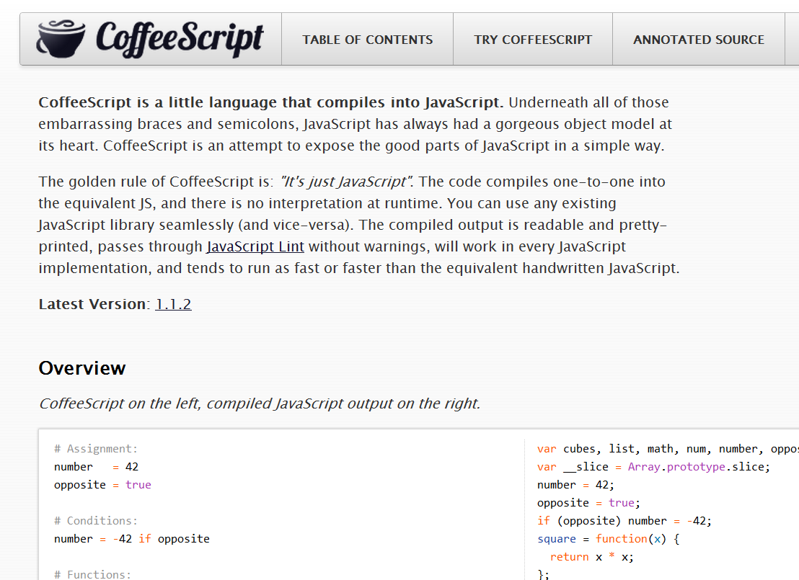
CoffeeScript Basics
Notes:
Let’s take a quick look at some CoffeeScript basics, for those who haven’t seen it before. As I said already, I’m not going to spend a ton of time here because you won’t remember it all, and this presentation is much more about the why than the how.
[DEMO] Go to the CoffeeScript Home page, sow the overview, as well as the try coffeescript pane and the “Load” link in each sample

Slide 32
Assignment
name = “Brandon”
married = yes
children = 2
var children, married, name;
name = "Brandon";
married = true;
children = 2;

Slide 33
Functions
square = (x) -> x * x
printInfo = (name, numChildren) ->
“Hi #{name}, I see you have #{numChildren} children.”
var printInfo, square;
square = function(x) {
return x * x;
};
printInfo = function(name, numChildren) {
return "Hi " + name + ", I see you have " + numChildren + " children";
};

Slide 34
Strings
num = 99
“I’ve got #{num} problems, and JavaScript ain’t one.”
city = "Brooklyn"
"No. Sleep. 'Till. #{city}"
var city, num;
num = 99;
"I've got " + num + " problems, but JavaScript ain't one";
city = "Brooklyn";
"No. Sleep. 'Till. " + city;

Slide 35
Objects
kids =
bigBrother:
name: “Benjamin”
age: 2
littleBrother:
name: “Jack”
age: 1
var kids;
kids = {
bigBrother: {
name: “Benjamin”,
age: 2
},
littleBrother: {
name: “Jack”,
age: 1
}
};

Slide 36
Lexical Scoping
outer = 42
findMeaning = ->
inner = 43
outer
inner = findMeaning()
var findMeaning, inner, outer;
outer = 42;
findMeaning = function() {
var inner;
inner = 43;
return outer;
};
inner = findMeaning();

Slide 37
Lexical Scoping 2
notGlobal = "Hello"
global = "Goodbye"
window.global = global
(function() {
var global, notGlobal;
notGlobal = "Hello";
global = "Goodbye";
window.global = global;
}).call(this);

Slide 38
Everything, an Expression
grade = (student) ->
if student.excellentWork
"A+"
else if student.okayStuff
if student.triedHard then "B" else "B-"
else
"C"
eldest = if 24 > 21 then "Liz" else "Ike"
var eldest, grade;
grade = function(student) {
if (student.excellentWork) {
return "A+";
} else if (student.okayStuff) {
if (student.triedHard) {
return "B";
} else {
return "B-";
}
} else {
return "C";
}
};
eldest = 24 > 21 ? "Liz" : "Ike";
Notes:
Compiler tries to make sure that all statements can be used as expressions, so the last statement of all blocks is returned.

Slide 39
Conditionals
mood = greatlyImproved if singing
if happy and knowsIt
clapsHands()
chaChaCha()
else
showIt()
lunch = if friday then water else redBull
options or= defaults
var lunch, mood;
if (singing) {
mood = greatlyImproved;
}
if (happy && knowsIt) {
clapsHands();
chaChaCha();
} else {
showIt();
}
lunch = friday ? water : redBull;
Options || (options = defaults);

Slide 40
Operators and Aliases
CoffeeScript | JavaScript
is, == | ===
isnt, != | !==
not | !
and | &&
or | ||
true, yes, on | true
false, no, off | false
@, this | this
of | in
in | no equivalent
Notes:
CoffeeScript ALWAYS compiled == into === and != into !==
“in” in CoffeeScript is used for loop comprehension and testing for array presence, not for testing object-key presence. To do that in CoffeeScript, use “of.” That’s an oddity that I don’t like.

Slide 41
Why?
Why use CoffeeScript?
Notes:
Now that we’ve gotten the “what is it?” and how does one learn it/use it, out of the way, let’s spend a moment talking about the why of coffeescript. As I said earlier, I’m not going to take for granted that you even want to learn coffeescript, and I’ve spoken to several people who claim to be “not sold yet.” So I want to spend a significant amount of time talking about why I think CoffeeScript is important, and less of a syntax overview.

Slide 42
Pros and Cons
Why?
Notes:
Now that we’ve gotten the “what is it?” and how does one learn it/use it, out of the way, let’s spend a moment talking about the why of coffeescript. As I said earlier, I’m not going to take for granted that you even want to learn coffeescript, and I’ve spoken to several people who claim to be “not sold yet.” So I want to spend a significant amount of time talking about why I think CoffeeScript is important, and less of a syntax overview.

Slide 43
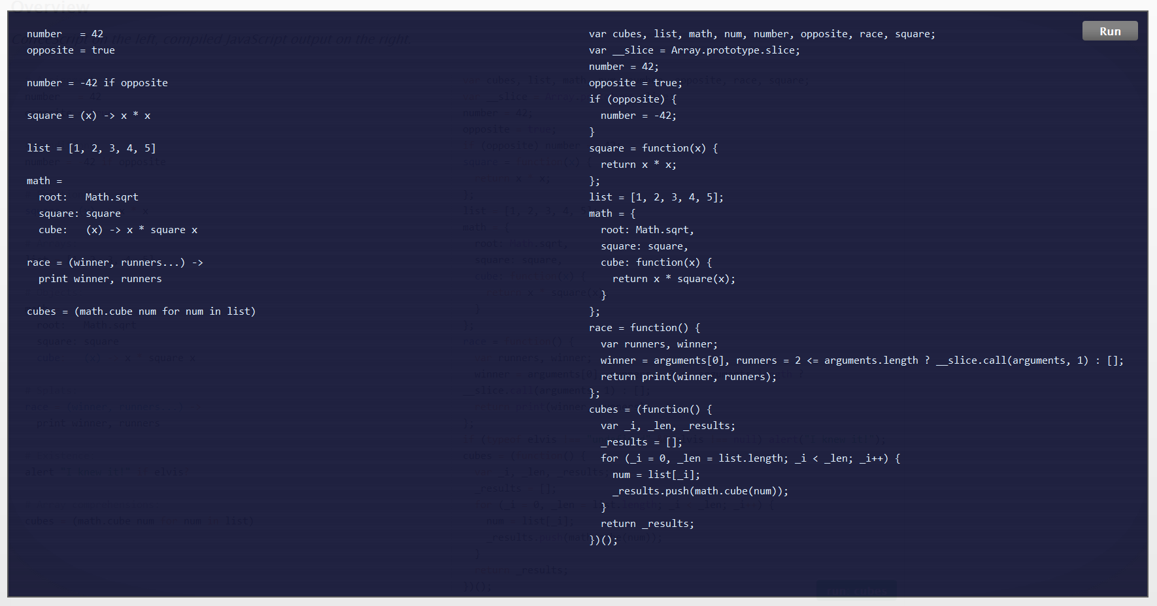
Pro
More succinct code
Notes:
CoffeeScript does tend to be more terse, mainly because of the lack of braces and use of whitespace.

Slide 44
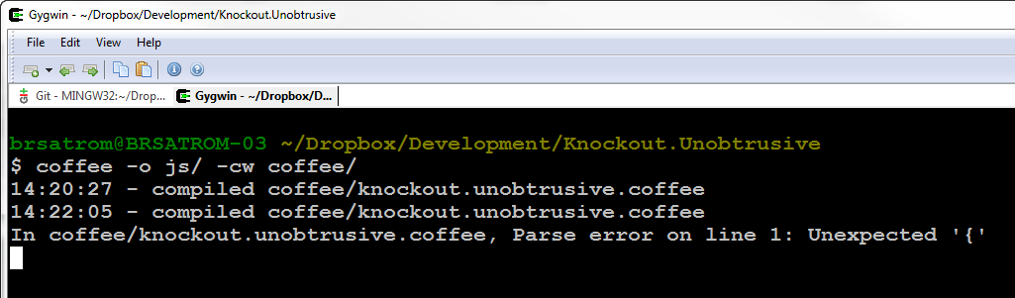
Con
Extra compile step between you and the “real” code
Notes:
There’s an extra compile step between the code you write in CoffeeScript and the code your site eventually executes, which is still JavaScript.

Slide 45
Pro
hi == bye
global = "everywhere?"
switch day
when "Fri", "Sat"
if day is bingoDay
go bingo
go dancing
when "Sun" then go church
else go work
(function() {
var global;
hi === bye;
global = "everywhere?";
switch (day) {
case "Fri":
case "Sat":
if (day === bingoDay) {
go(bingo);
go(dancing);
}
break;
case "Sun":
go(church);
break;
default:
go(work);
}
})();
Avoid Snake Pits & Get JS Patterns for Free
Notes:
Avoids the "snake pits" of JavaScript
coercive equality, with(), fall-through-switch statements
Js Design patterns are features of JS
Lexical scoping - no global variables

Slide 46
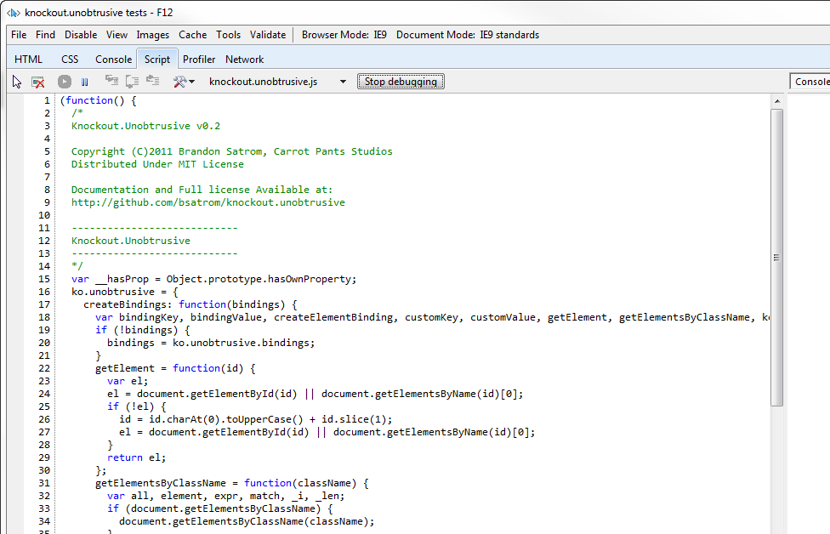
Con
Errors and Debugging: it’s still JavaScript in there
Notes:
But when it comes time to debug issues in your CoffeeScript, you do still have to debug in JS.

Slide 47
Pro
Conjecture!
As fast or faster JavaScript
Notes:
There’s a claim on the site that the CoffeeScript you write will output JavaScript that’s as fast or faster than the JS you write today. This is obviously anecdotal, and based largely on the assumption that you use for each instead of raw for loops, which are faster.

Slide 48
Con
Code Generation(?)!
Dare I say it? Code Generation!
Notes:
CoffeeScript does generate JavaScript code that you have to live with. That was my first sticking point at the beginning.

Slide 49
Improve Your JavaScript
Why?
Notes:
Now that we’ve gotten the “what is it?” and how does one learn it/use it, out of the way, let’s spend a moment talking about the why of coffeescript. As I said earlier, I’m not going to take for granted that you even want to learn coffeescript, and I’ve spoken to several people who claim to be “not sold yet.” So I want to spend a significant amount of time talking about why I think CoffeeScript is important, and less of a syntax overview.

Slide 50
The Five Stages of JavaScript
Avoidance
Concession
Abstraction
Failure
Enlightenment
Notes:
I would refer to my own journey with JS as the Five Stages of JavaScript.
Now I’m not a doctor, so I can’t generalize these experiences to everyone, but they did hold true for me.
Avoidance - 1996
Lazy JavaScript
Browser Sniffing
Concession - 2003
Semi-Lazy JavaScript
Ajax
Abstraction - 2006
jQuery FTW!
jQueryScript
Failure - 2009
Hey, JavaScript is pretty nice!
HTML5
Trying to write my own jQuery Plugin
And JavaScript libraried by hand
Enlightenment - 2011
HTML5
JavaScript books like Eloquent JavaScript, JavaScript the good parts
CoffeeScript has only continued that trend.

Slide 51
arr = new Array(4, 8, 15, 16);
arr[4] = 23;
arr[5] = 42;
for (i = 0; i < arr.length; i++)
{
enterLottoNum(arr[i]);
}
Notes:
Let’s talk a little bit more about stage 5, and what role CoffeeScript has played in my growth as a JavaScript programmer.
Here’s an example of some JavaScript I might have written 10 years ago, when being a web developer was more about back-end frameworks than the client. I’m sure you can see, as I do now, a few of the horrible mistakes I made with this code.

Slide 52
var arr = [4, 8, 15, 16, 23, 42];
for (var i = 0; i < arr.length; i++) {
enterLottoNum(arr[i]);
}
Notes:
Here’s an example of some JavaScript I might have written a few years ago. Much better, because I actually understood the language.
While this is worlds better than the JS I originally wrote, there are still a few minor best-practices I discovered I am violating, but I didn’t catch until I started using CoffeeScript.

Slide 53
var arr, num, _i, _len;
arr = [4, 8, 15, 16, 23, 42];
for (_i = 0, _len = arr.length;
_i < _len; _i++) {
num = arr[_i];
enterLottoNum(num);
}
Notes:
This, is what I learned to write after reading the output generated by CoffeeScript. The differences are subtle, but I’m guessing that some of you see them. Two differences, in fact. For one, I’m declaring my iterator variable at the top of the scope, as I should. Then, I’m assigning the length of my array to a variable, so that I only access the unchanging length property once, as opposed to every time through.
These are subtle differences, I know. And I also know that some of you probably learned to use them without the help of CoffeeScript. For that, I applaud you. [Next Slide]

Slide 54
CoffeeScript made me want to be
a better man
JavaScript
Programmer
Notes:
But for me, I’m a very kinetic learner. Working through exercises in a book is useful, but I learn best when I’m using a living with a debugging a thing. Working with CoffeeScript was, for me, like having my ideas about a web program expressed by another developer. Not a better or poorer developer, because I didn’t always agree with those opinions. But in areas where I hadn’t yet internalized a pattern or good practice, CoffeeScript generated JS that I was able to learn from and internalize.
I’m still in the fifth stage, if only barely, but if there’s anything that’s true it’s that there is no sixth stage. There is nothing beyond JS, and embracing CS wasn’t about that, but about becoming a better JS priogrammer.
Learning CS helped me better learn JS. Reading and debugging my CS made me a better JS developer, because I learned about the patterns and conventions it conveyed. And it did all of this without creating a lot of JS that I couldn’t read and debug myself.

Slide 55
All or Nothing?
Why?
Notes:
Now that we’ve gotten the “what is it?” and how does one learn it/use it, out of the way, let’s spend a moment talking about the why of coffeescript. As I said earlier, I’m not going to take for granted that you even want to learn coffeescript, and I’ve spoken to several people who claim to be “not sold yet.” So I want to spend a significant amount of time talking about why I think CoffeeScript is important, and less of a syntax overview.

Slide 56
CoffeeScript is not an all-or-nothing choice
Notes:
There doesn’t have to be a JS-vs-CS choice here.

Slide 57
Consider using CoffeeScript…
→ As your test language (via Jasmine)
→ For your server-side code in a Node.js App
As a JavaScript training tool
Wholesale (Soon with browser Source Maps)
Notes:
Adopting CS doesn’t have to be about using it to replace your front-end code. Many use CS to drive their tests, something which is dead-simple in Jasmine, while keeping their production code in JavaScript, and personally think this is a great approach. You can also use CoffeeScript with your Node apps, but leave JS on the front-end. Another option is something I’ve done in the past, which is to use CS for some app-building, but primarily to inspect the output and learn more about JS by learning how CS generates JavaScript to solve certain problems.
And of course, you can adopt CS wholesale. Interestingly, not being able to debug CS in the browser might soon be a thing of the past as Chrome current does and FireFox will soon support Source Maps, which allows you to map transpiled JS code back to line numbers in a source-language file. CS should soon implement this natively, which is something worth checking out.

Slide 58
Influencing JS.Next
let name = “block scoped!"
const REALLY = "srsly"
#add(a, b) { a + b }
module Mod {
export const K = “foo”
export #add(x, y) { x + y }
}
Function
Declaration!
Why?
Notes:
But no matter how you choose to use CS, or even if you choose not to, you need to know it, if for no other reason than to learn how it’s influencing JS.NET. Brendan Eich has said that JS.Next is being influenced by CoffeeScript, and Jeremy himself has claimed that as a goal for the language.
The truth it, JavaScript is evolving. It’s not the unchanging language of the last decade. We can insist that it’s fine as is, but it’s going to change anyway. Hopefully you’re aware of some of those proposed changes. And using a languages like CoffeeScript help you evolve you thinking of JavaScript and open your mind to what’s possible in the future.
The code example above is taken from the “Harmony of My Dreams” blog post by Brendan Eich (http://brendaneich.com/2011/01/harmony-of-my-dreams/

Slide 59
JavaScript Gets Better
JavaScript
jQuery, et al.
ECMAScript 5
CoffeeScript
Harmony/JS.Next
?
Notes:
The point is that CoffeeScript isn't a destination, any more than JavaScript is. It's a step on the process. It makes the language better, and we get better as a result…
Jquery and Frameworks made JavaScript and working with the DOM better, and it influenced how we use the language (querySelector() is proof of that)

Slide 60
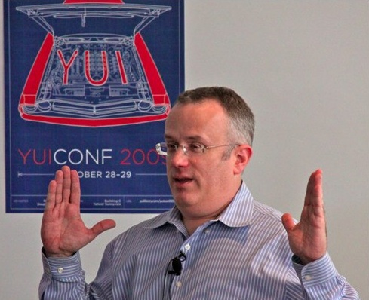
CoffeeScript Is not a replacement for JavaScript
"We are not just advocating a language on top of JS that you use to avoid JS (GWT, Haxe, Objective-J, etc.). We are advocating that you all help build a better JS on JS, which then becomes standardized as JS.next."
- Brendan Eich
Notes:
According to Brendan Eich, this is about bringing JavaScript full circle, not about replacing, but enhancing JavaScript. We shouldn’t see CoffeeScript as a threat to JavaScript because it wasn’t born in the same spirit as languages like GWT and Dart, where staying as far away from JS is the goal.
"We are not just advocating a language on top of JS that you use to avoid JS (GWT, Haxe, Objective-J, etc.). We are advocating that you all help build a better JS on JS, which then becomes standardized as JS.next." - Brendan Eich (re: his talk with Jeremy at JSConf.EU)

Slide 61
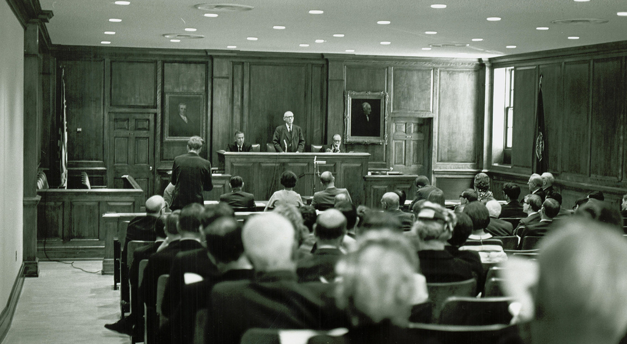
The People vs. The WHATWG, TC39 and the W3C
CC image copyright William & Mary Law Library, used with Permission - http://www.flickr.com/photos/wolflawlibrary/5051047245/
Notes:
What I take that to mean, ultimately, is that we, as developers and designers, have a voice in this process. Yes, we can join community groups and standards bodies and influence the web that way. That’s a top-down process, or the Cathedral from Eric S. Raymond’s seminal essay, The Cathedral and the Bazaar. And borrowing from Raymond’s analogy, languages like CoffeeScript, LESS and SASS represent the Bazaar. The marketplace where ideas are born, vetted and thrive in the context of day-to-day work. We need the standards process, the Cathedral, but we also need the bazaar. Together, these two seemingly opposed forces come together to drive our industry forward.

Slide 62
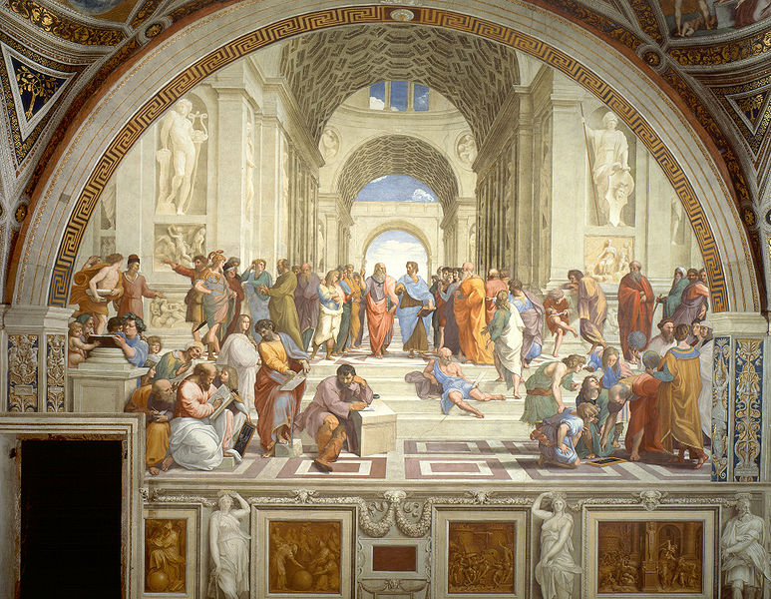
the JavaScript Dialectic, Revisited
What Can I/We/Everyone Learn from CoffeeScript?
Notes:
SO… In the spirit of the dialectic, here’s my proposal: “JavaScript is a beautiful language, but it has its snares and pitfalls. What’s more, it is constrained severely by backwards compatibility and committee-driven design. CoffeeScript IS JavaScript, but a dialect that experiments with what JavaScript could be were it unencumbered, all the while staying faithful to the language. I believe that, as a community, we should embrace CoffeeScript because it represents a movement, not to replace JavaScript, but evolve and improve upon it. Embracing might mean using the language and becoming a better JavaScript developer as a result. Or it might mean using it, and seeing a vision of how JavaScript can be improved. You don’t have to “adopt” it if you don’t want to, but you should be aware of it.”

Slide 63
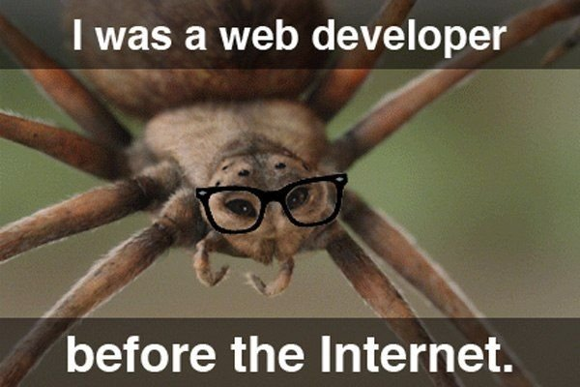
Questions?
@BrandonSatrom
brandon@kendoui.com
UserInExperience.com

